Slide 1

Multidisciplinary Teams in IT: A Blend of Expertise and Culture
Matthew Schneider

Slide 2
Agenda :
Introduction – Definition and Importance
Benefits of Multidisciplinary Teams
Challenges in Multidisciplinary Teams
Importance of Culture in Multidisciplinary Teams
Strategies for Building and Nurturing Multidisciplinary Teams

Slide 3

Definition and Importance
Definition of multidisciplinary teams
Importance in the computing profession e.g. UI/UX, Development, Product Management, Sales, Support and Customer Success
Emphasis on capability and neurodivergent individuals
Innovative solutions
Example: Microsoft's Autism Hiring Program, recognizing the unique strengths of neurodiverse individuals.
Notes:
A multidisciplinary team is a group of individuals from diverse disciplines or professions who come together to collaborate and contribute their expertise toward achieving a common goal or objective. These team members bring unique skills, knowledge, and perspectives, allowing for a more comprehensive approach to problem-solving, decision-making, and project execution. The collaboration within a multidisciplinary team often leads to innovative solutions that might not be achievable by individuals or homogenous teams working in isolation.

Slide 4

Benefits of Multidisciplinary Teams

Slide 5
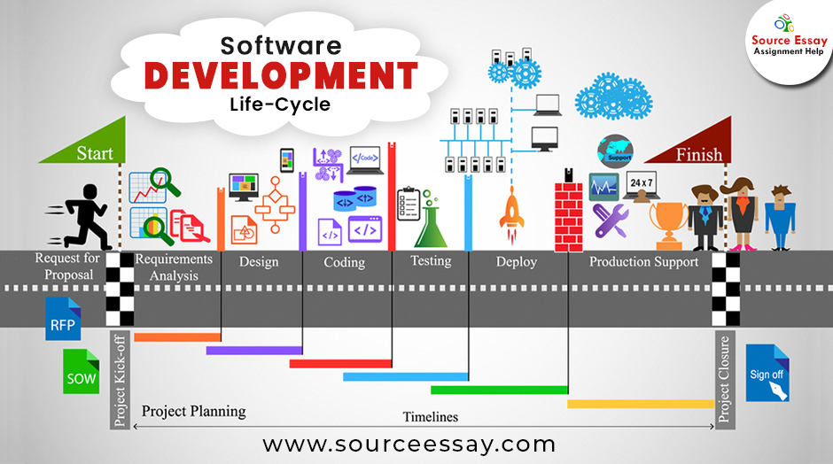
Diverse Expertise and Knowledge
Overview of disciplines: software engineering, data science, UX design, Commercial, Lawyers, product manager
Engaging with diverse backgrounds, cultures, skills, etc.
Example: Spotify's use of "squads", "tribes", and "guilds" to foster cross-functional collaboration.

Slide 6

Enhanced Creativity, Efficiency and Innovation
Cross-pollination of ideas
Different perspectives leading to novel solutions
Division of labor and specialization
Combination of complementary skills for optimal results
Example: Google's collaboration between its AI researchers and traditional artists for the Magenta project

Slide 7

Challenges in Multidisciplinary Teams

Slide 8
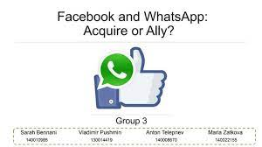
Communication and Collaboration
Overcoming language and jargon barriers
Effective use of communication tools
Skills
Background
Recognizing and valuing diverse opinions
Facilitating constructive discussions
Example: Global teams at IBM using collaboration tools like Slack to bridge communication gaps.

Slide 9
Alignment of Goals & Managing Conflicts
Develop a common language and understanding
Share experience of team
Co-Create common goals and purpose
Establish a shared vision
Balance individual and team objectives
Manage different people, skills, experience and expectations
Example: Conflicts at WhatsApp after its acquisition by Facebook, emphasizing the importance of aligning visions and goals.

Slide 10

Importance of Culture in Multidisciplinary Teams

Slide 11

Definition and Cultural Considerations
Definition of team culture
Geographical, organizational, and professional culture
Improved collaboration and trust
Higher employee satisfaction
Enhanced creativity
Example: Google's emphasis on a positive work culture leading to high employee satisfaction rates.

Slide 12

Strategies for Building and Nurturing Multidisciplinary Teams

Slide 13
Recruitment and Hiring
Assessing minimum requirements for roles
Qualifications
Experience
Identifying diverse skill sets
Evaluating cultural fit
Example: Airbnb's emphasis on hiring for cultural fit as much as for skills.

Slide 14
Team Building and Training
Icebreakers and trust-building exercises
Cross-training initiatives
Regular team meetings
Technology for virtual collaboration
Example: Dropbox's "Hack Week" fostering cross-team collaboration and innovation.

Slide 15
Real-World – Teams for Products
Inception
Design
Build
Deploy
Scale
Exit
Investment
Customer
Product Manager
Lawyers
Commercial
Software Developer
Architecture
User Experience
Subject Matter Expert
Support & Customer Success

Slide 16
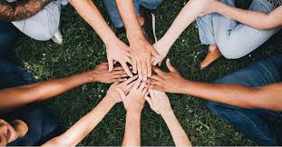
Conclusion

Slide 17
Multidisciplinary - Teams Rock
Importance of multidisciplinary teams
Role of culture in fostering collaboration
Encouragement to embrace the power of multidisciplinary teams
All of your work will involve interacting/managing/influencing teams

